Slide 1

as a potential car buyer, What factors contribute to owning a car in sg?
DAVI ca2
an analysis on Singapore Transport data
By: Justin wong juin hng (p2112646)

Slide 2
Introduction
Who am I?
A potential car buyer in Singapore
What am I looking to do?
I am looking to analyse Singapore’s Transport Data to give me the best bang for my buck for all aspects related to car ownership
What are my resources?
I have about 150,000 to pay for the car

Slide 3
Objectives
Introduce Visualised Data
Explain purpose of Data Visualisation
Description of Data Visualisation
Analysis of insights gathered Visualisation
Is it still viable / worth it for me to buy a car in Singapore?
Credits

Slide 4
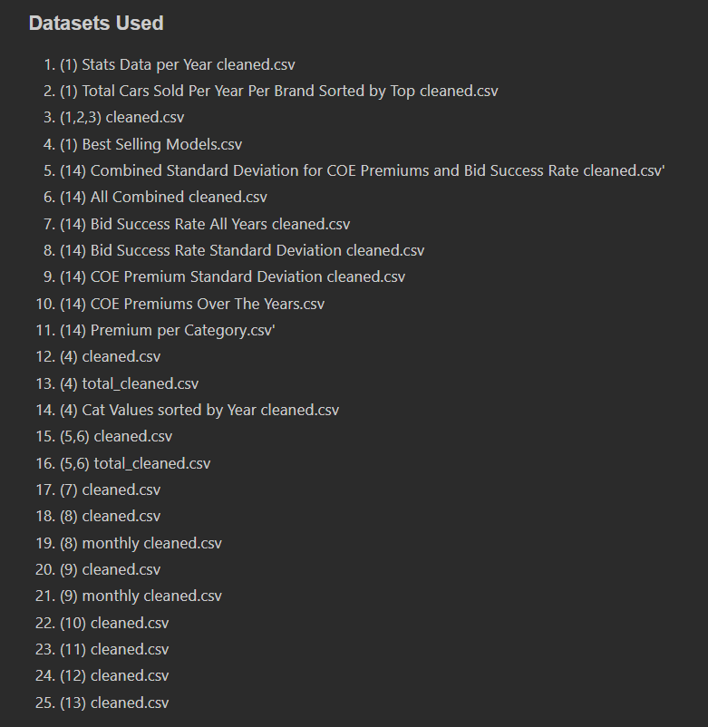
dataset(s) used

Slide 5
Objective of data analysis
As a potential car buyer in Singapore, I am looking at:
What road facilities am I provided with as a car buyer?
How much are average fuel prices?
After I’m done driving, where do I park my car?
What are the most popular brand of cars sold and their respective models? How much do I have to pay for COE?
What are the most common accidents? If I get into an accident, what are the average vehicle insurance prices
1
2
3
4
5

Slide 6
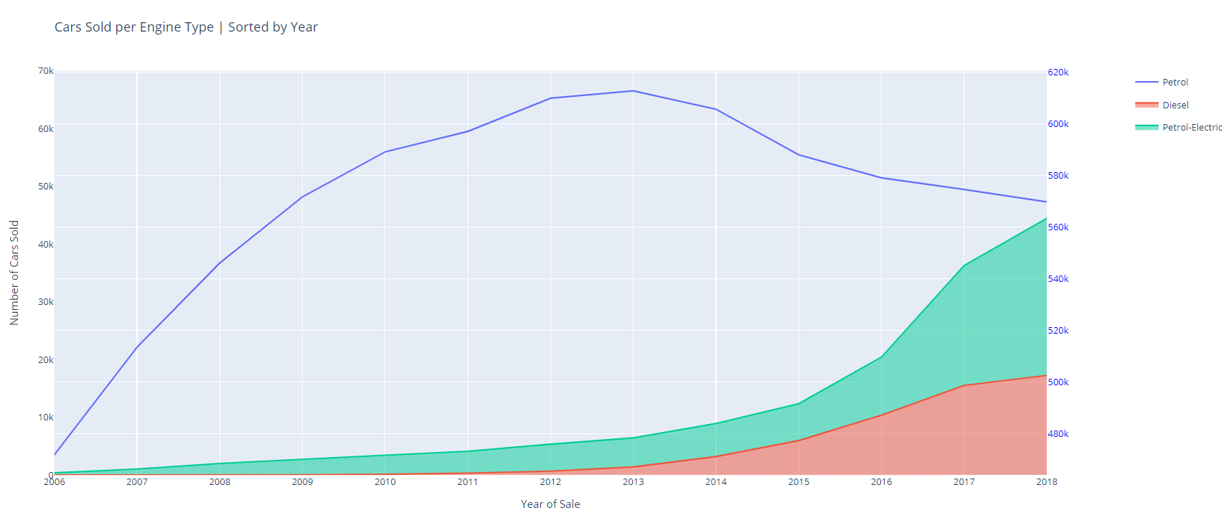
What kind of car should I buy? Why does that matter?

Slide 7
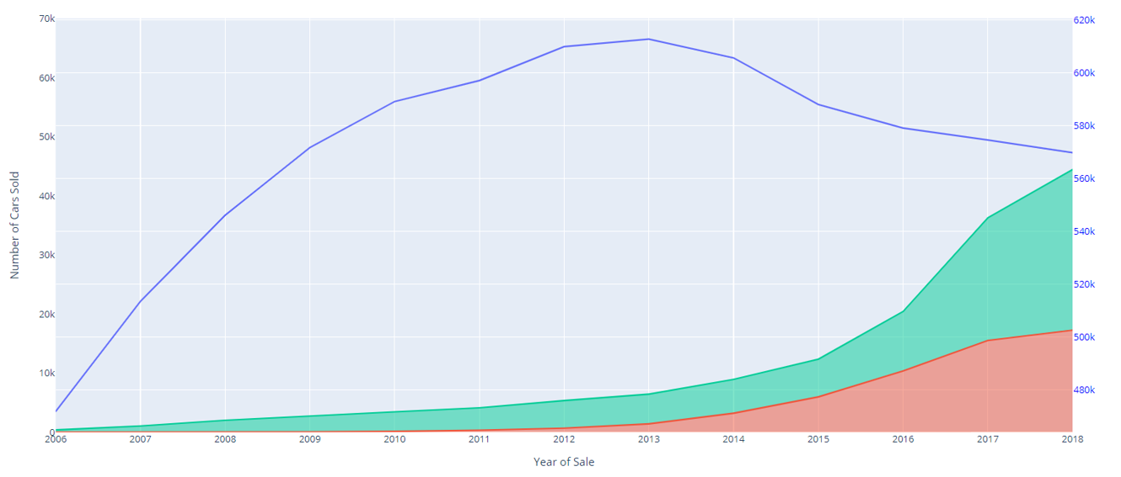

Explanation of insights
loves to drive petrol cars
petrol electric cars has actually quite literally, skyrocketed over the past few years
petrol cars still top the charts
greater availability of services such as petrol stations
petrol electric cars are catching on.

Slide 8
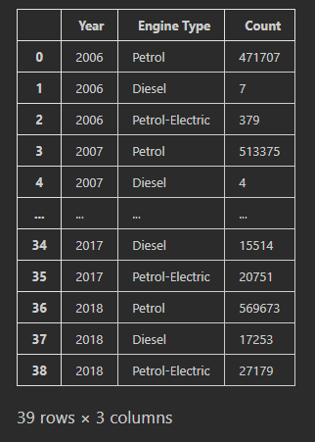
Data Dictionary
No. of cars purchased per engine type, per year

Slide 9
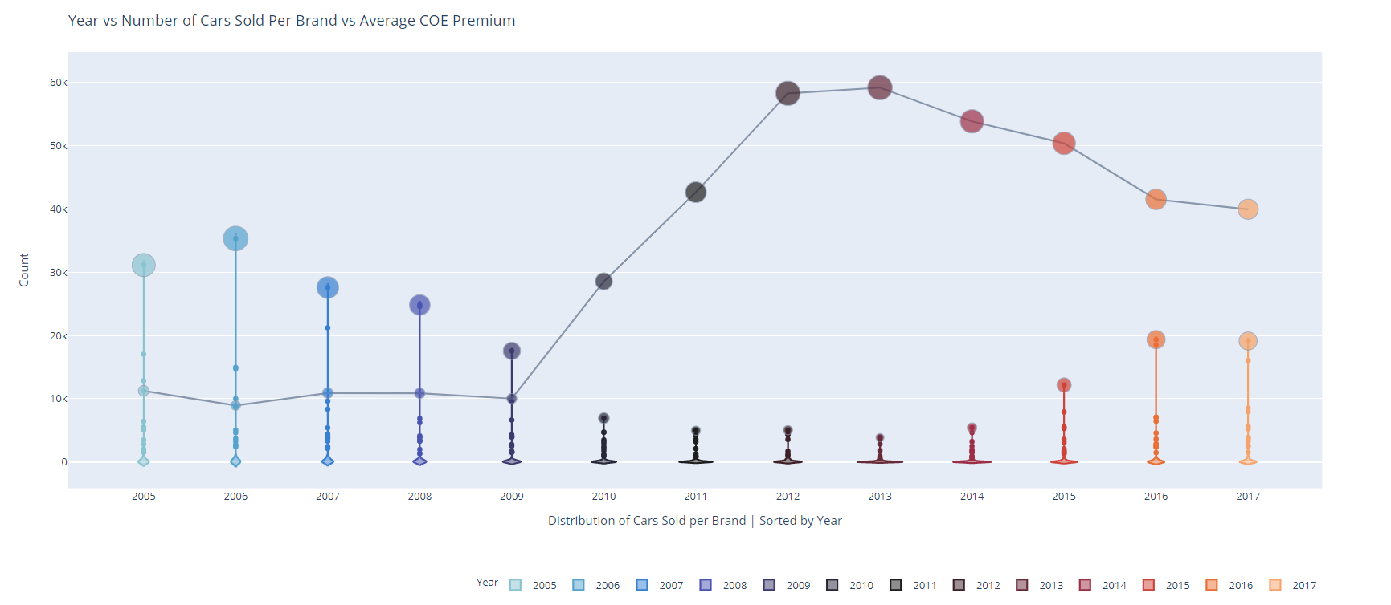
What are the most popular car brands sold over the years? What brand should I buy?

Slide 10
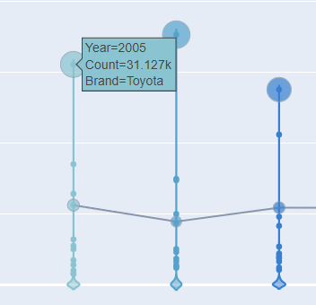
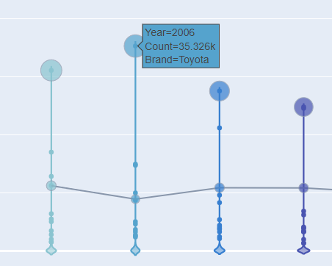
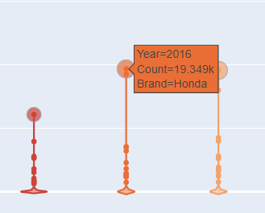
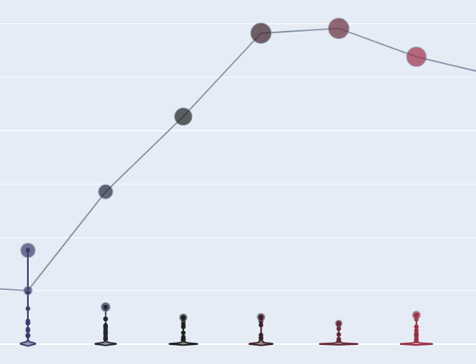
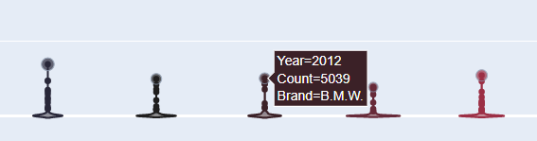
Explanation of insights
Top Brands: Toyota, Honda, with both averaging more than 15,000 models per year
Toyota easily surpassing the 15k model count, at an average of 30,000 models sold on average
Why?
Toyota builds solid, efficient, and reliable vehicles
Standard safety features such as automatic emergency braking and forward-collision warning systems
However:
high disposable income
Every year, they’ve been selling about the same amount
proportion of buyers with who purchase Toyota disappeared
increase in COE prices did not matter to them

Slide 11
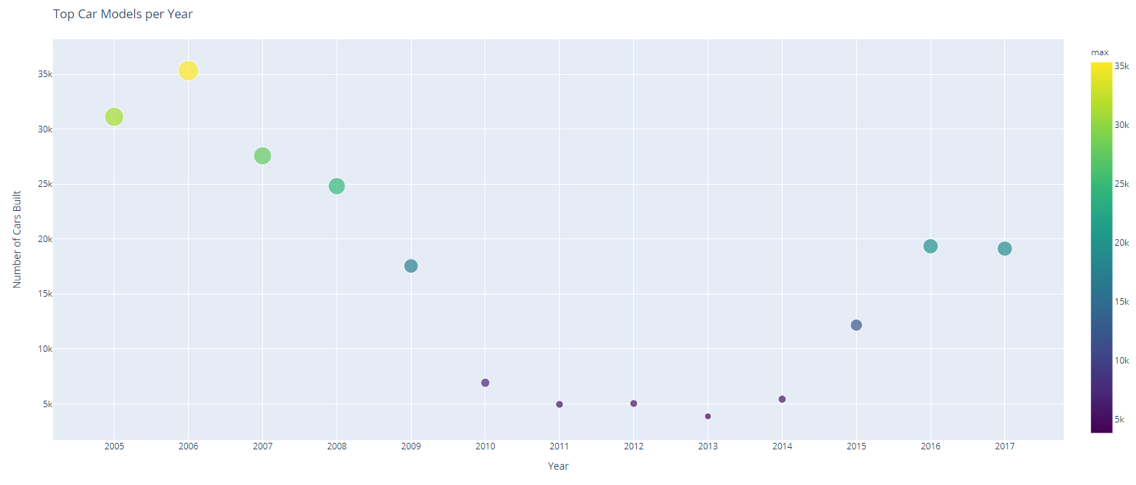
What are the most popular model of cars sold? What model should I buy?

Slide 12
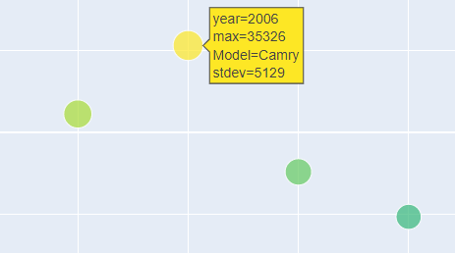
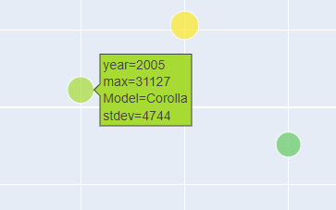
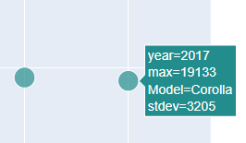
Explanation of insights
The base four-cylinder engine on the Camry returns good fuel economy estimates
Camry is
roomy
supportive seats
intuitive tech features
Simple
Economic
Reliable
Budget friendly pricing
Fuel efficient
Caters to the largest consumer base

Slide 13
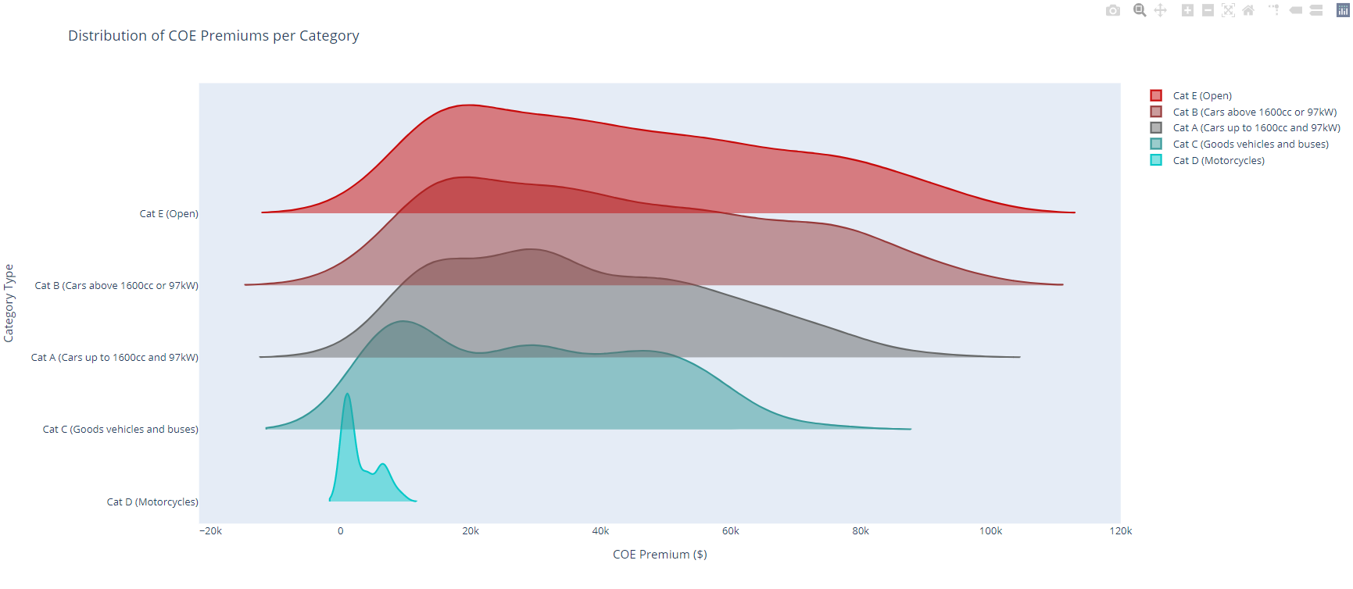
How consistent are Coe Prices per Category? What category should I stick to?

Slide 14
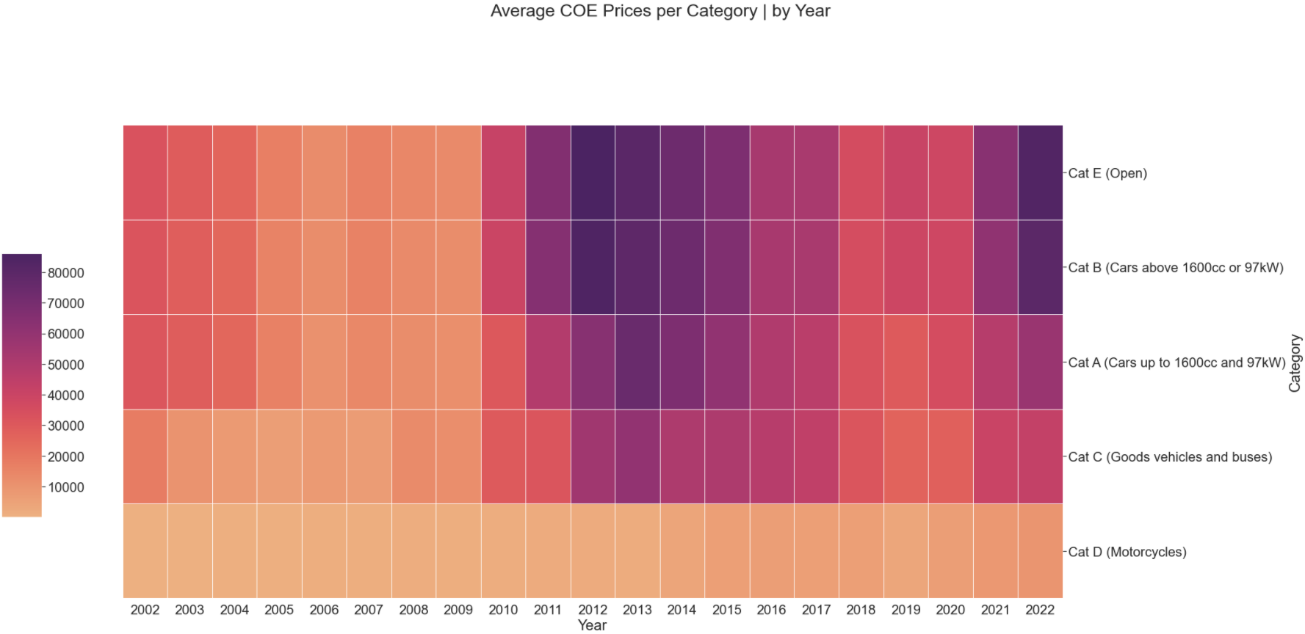
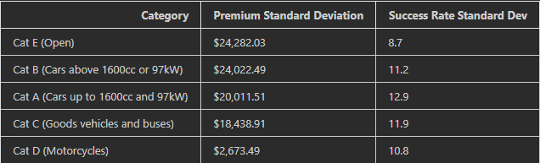
Explanation of insights
5 categories. Cats A to E
Cat A
Cat B
Cat C
Cat D
Cat E
Prices for Cat B and Cat E cars are pretty similar
standard deviation upwards of $4,000 more than the Category A
Very inconsistent as compared to category A
Level of customisation & variability much higher than that of Cat A.
From Cat E to Cat A, the standard deviation for success rate in COE applications increases
Cat E consumers are more likely to get their COE approved as compared to Cat A
amount of people buying such cars are just simply lesser
Cat A, where the success rate is about 5% lower than that of Cat E
Well, we’ll just bid higher and simply pay more

Slide 15
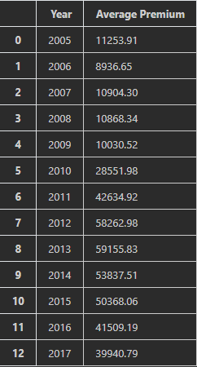
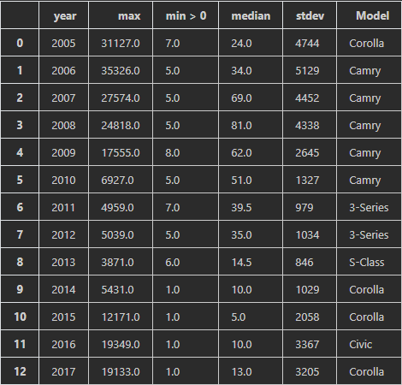
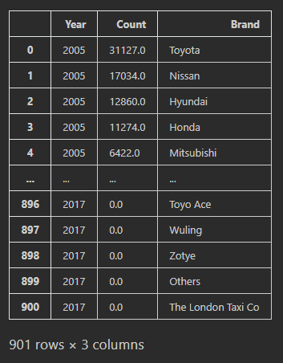
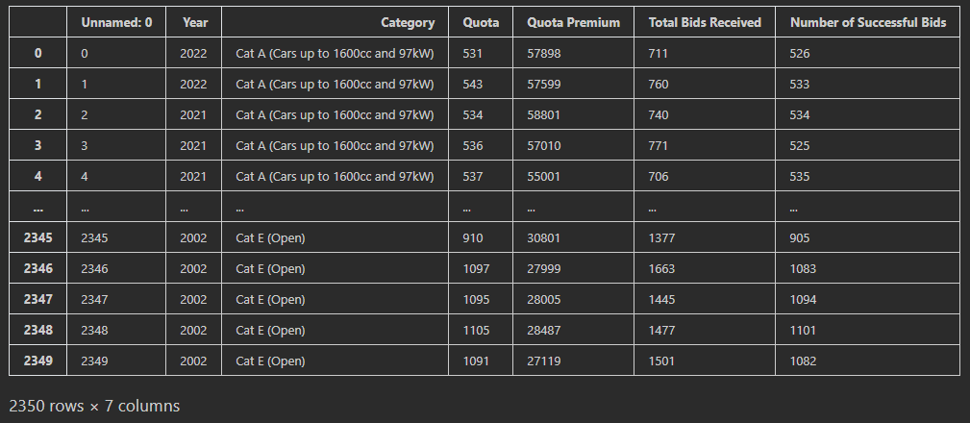
Data Dictionary
Average COE Premium per year
COE Premium statistical data per year
No. of cars sold per brand, per year
Vehicle Category Data per year

Slide 16
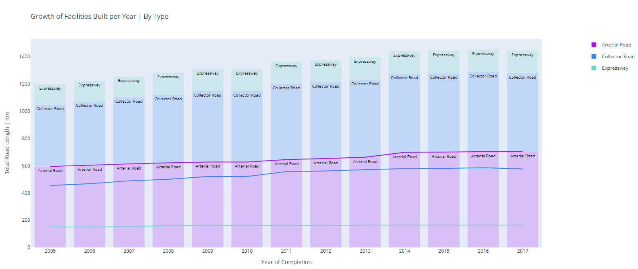
how much road is being paved each year? Why does that matter?

Slide 17
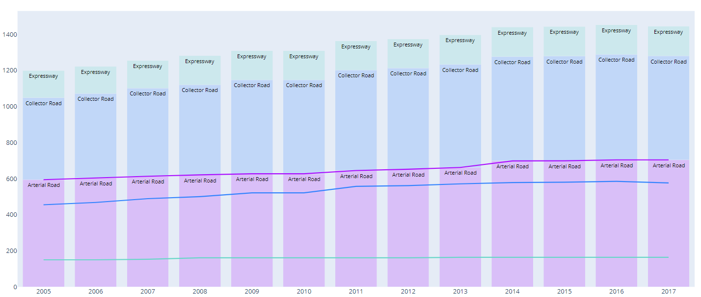
Explanation of insights
For all 3 road types, there is upward growth:
1194 kilometers in 2005 to 1444km in 2017
Increase of 20% in just 12 years
Singapore government is putting in effort
increase the interconnectivity of our island
paving more roads for us drivers to use
If I buy my car:
No need to worry about not having enough space on the road
not having to worry where my destination is

Slide 18
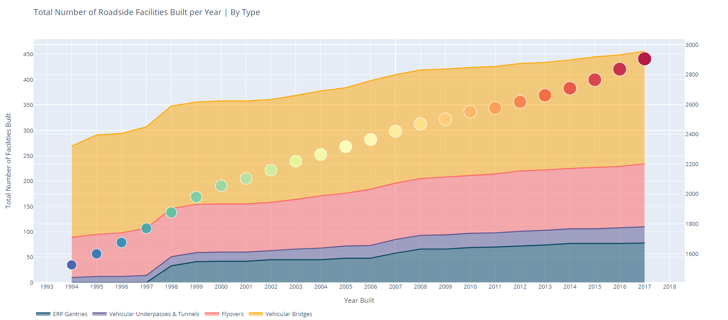
What is the growth of roadside facilities constructed? Why does that matter?

Slide 19
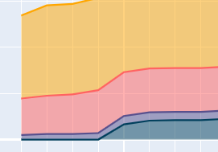
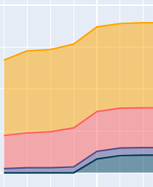
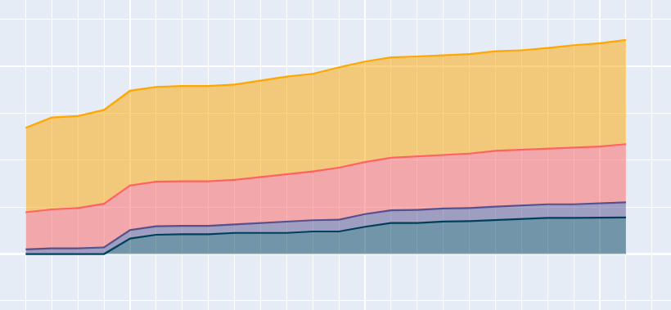
Explanation of insights
1994 to 2017, there is an upward trend in the number of facilities constructed:
Vehicular tunnels, Flyovers and ERP gantries seeing significant growth
From 1525 facilities in 1994 to 2905 facilities in 2017, up a whopping 90%
there are many ways and methods for me to reach my destination
lesser likelihood that I'll be stuck in a jam
more facilities available to reduce the average load per length of road
reducing congestion and waiting time

Slide 20
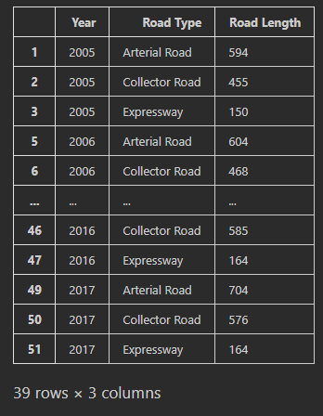
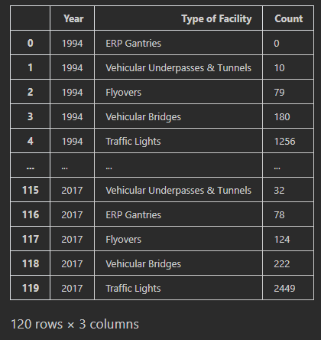
Data Dictionary
Road length paved per type, per year
No. of facilities built per type, per year

Slide 21
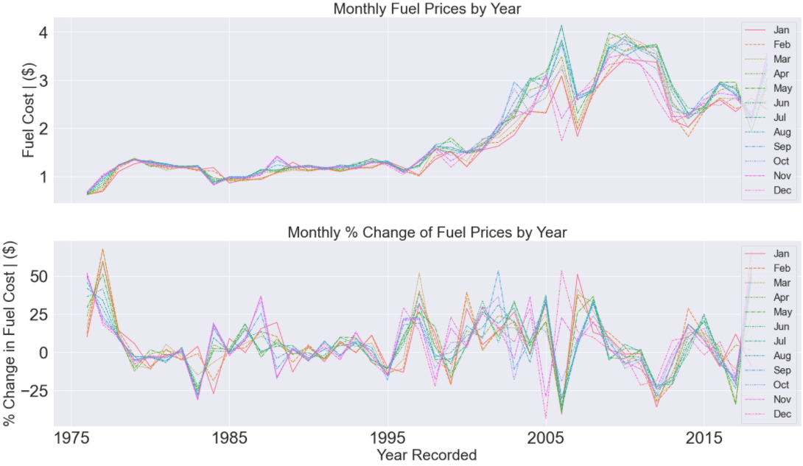
How much are fuel prices? Why does that matter?

Slide 22
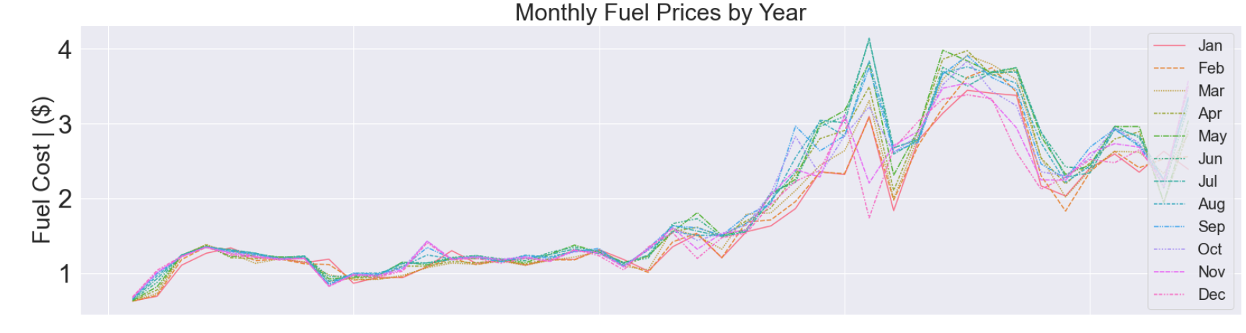
Explanation of insights
Surge in prices, from 1975 to 2020
Upwards of four times what we had in 1975
But why?
Extreme weather events led to longer-than-typical periods of cooling and heating
fuel supplies depleted
while supplies would usually be replenished during winter
heatwaves and droughts in regions kept energy needs high
A rebound from COVID-19 ramped up demand from Asian economies
Supply failed to keep up
Production of liquefied natural gas worldwide has been lower than expected
Series of unplanned outages across the globe
Maintenance of gas infrastructure delayed
Thus:
European gas benchmark, Dutch TTF, has rallied 290 per cent since the start of the second quarter
Asia LNG spot prices were up 260 per cent while US natural gas prices nearly doubled over the same period.

Slide 23
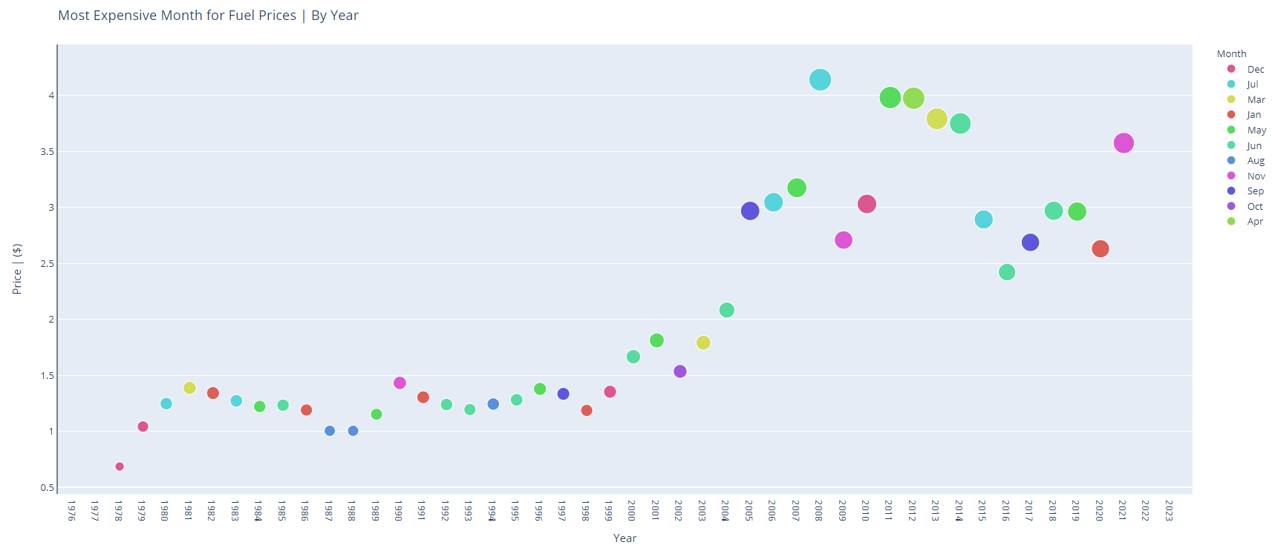
Is fuel expensive? why?

Slide 24
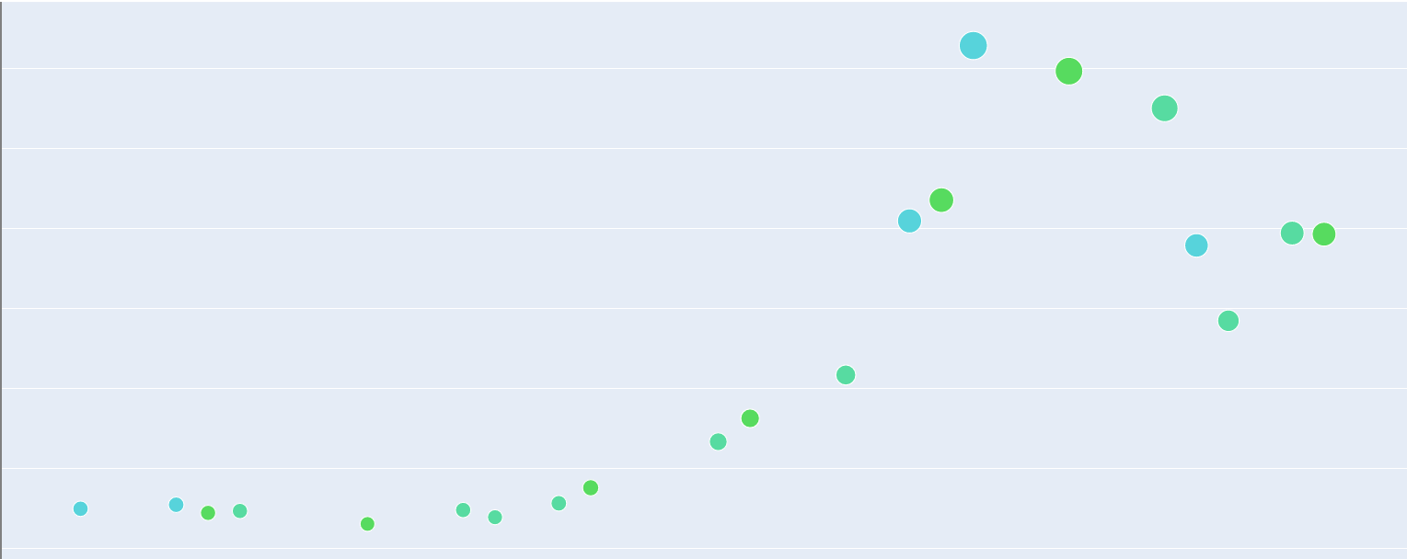
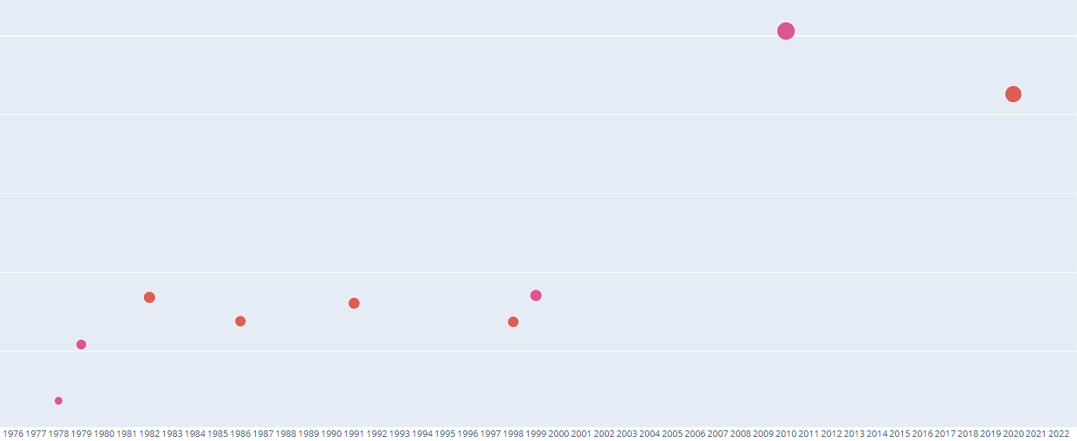
Explanation of insights
vs
Max Fuel Price Occurrences: June and July
Max Fuel Price Occurrences: Jan and Dec
Occurrence of highest fuel price is greater than that as compared to the two ends of the year
fuel is only imported during the winter
supplies are much higher during the january and December
supply has increased, and demand stays the same, the prices for fuel go down
highest fuel prices in each year not occurring as frequently during this time period of January and December.
when fuel supplies begin to run short:
occurrences of highest fuel prices in each year occurring more frequently during June and July
exactly matching when supplies begin to run short
law of supply and demand, fuel prices get exponentially higher

Slide 25
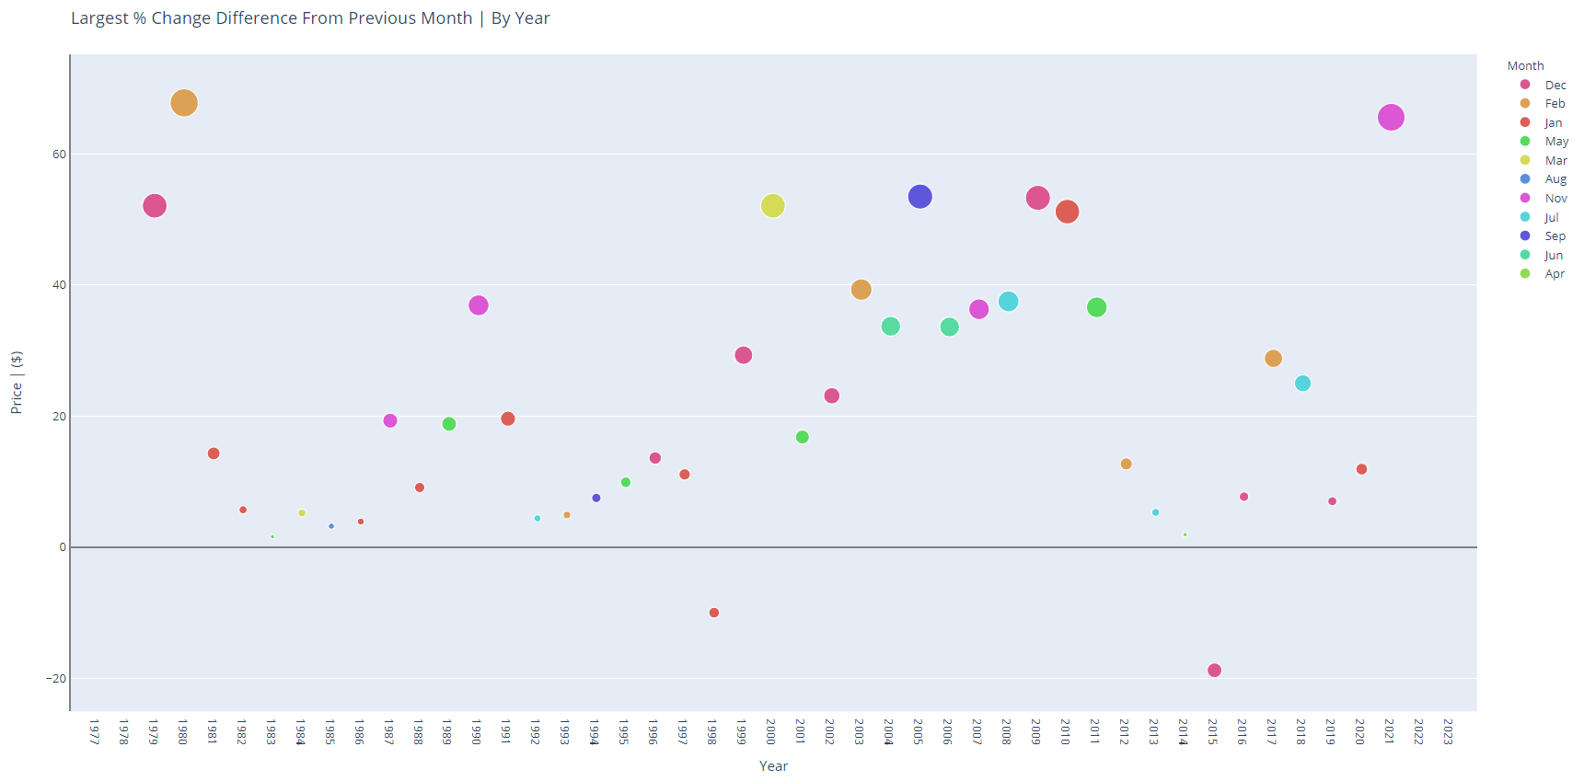
How consistent are fuel prices? When should I buy fuel?

Slide 26
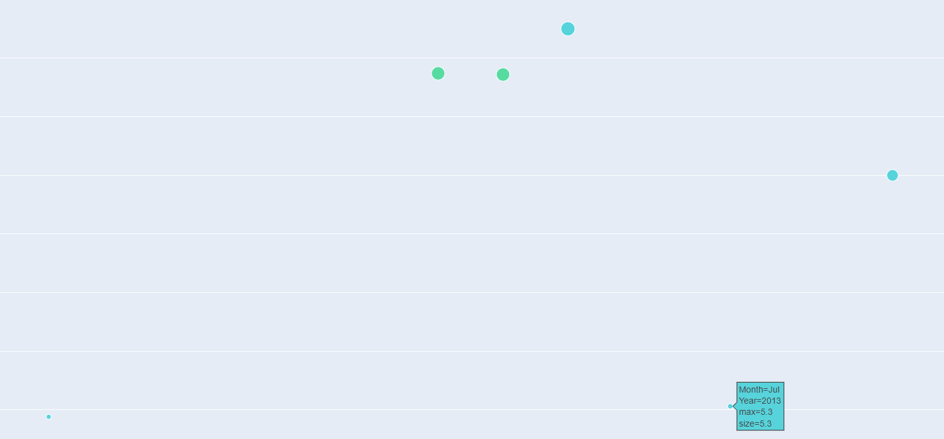
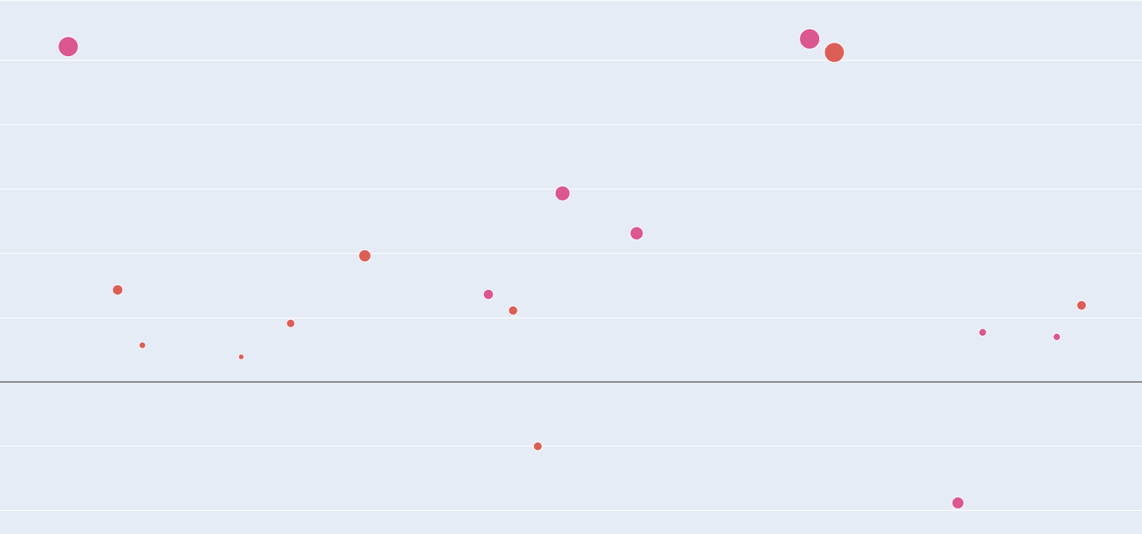
Explanation of insights
vs
Highest % Difference Occurrences: June and July
Highest % Difference Occurrences: Jan and Dec
If this value is high, that means that fuel prices are inconsistent, and vice versa
june and july, do not have most occurrences
prices at the end of the year, are actually more inconsistent than that during the middle of the year
fuel prices are more consistent during june and July
causes frenzy and mayhem to occur all over the country as companies fight with one another to either lower or increase fuel prices:
constant fluctuations in fuel prices.
law of supply and demand, fuel prices get exponentially higher

Slide 27
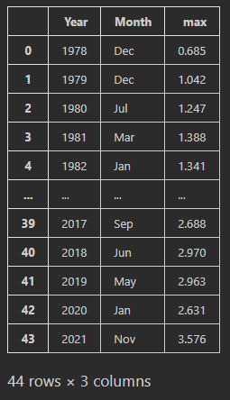
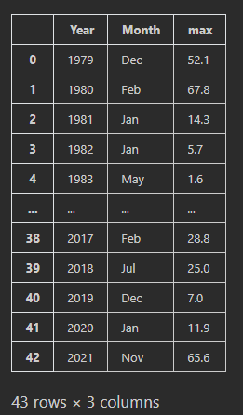
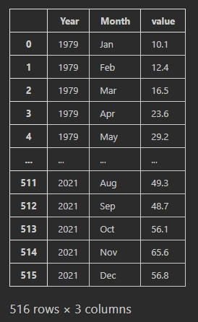
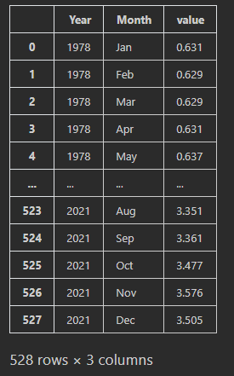
Data Dictionary
Highest fuel price per year
Highest fuel price % difference per year
Fuel price per month per year
Fuel price % difference per month per year

Slide 28
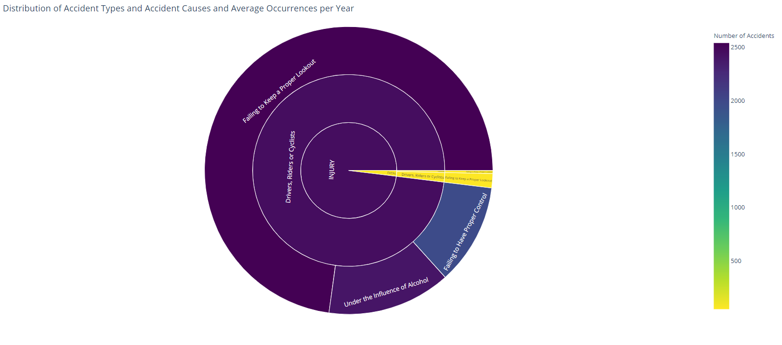
What accidents are most common on the road? Why?
Type of Accident

Slide 29
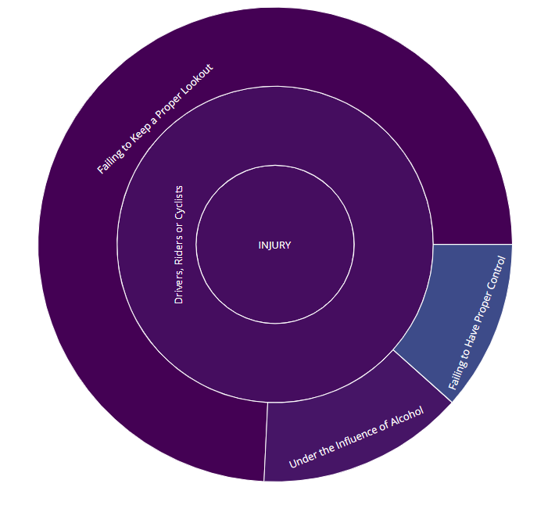
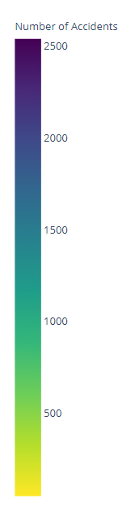
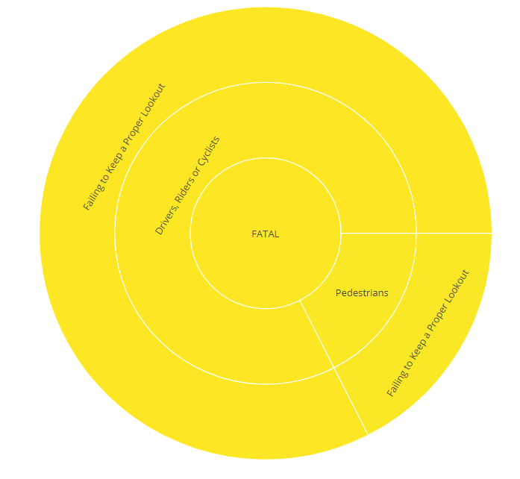
Explanation of insights
90 percent of accidents result in injuries
Drivers, riders, or cyclists
2500 accidents per year
Dor the 10 percent of fatal injuries
Drivers, riders and cyclists just can't seem to pay attention

Slide 30
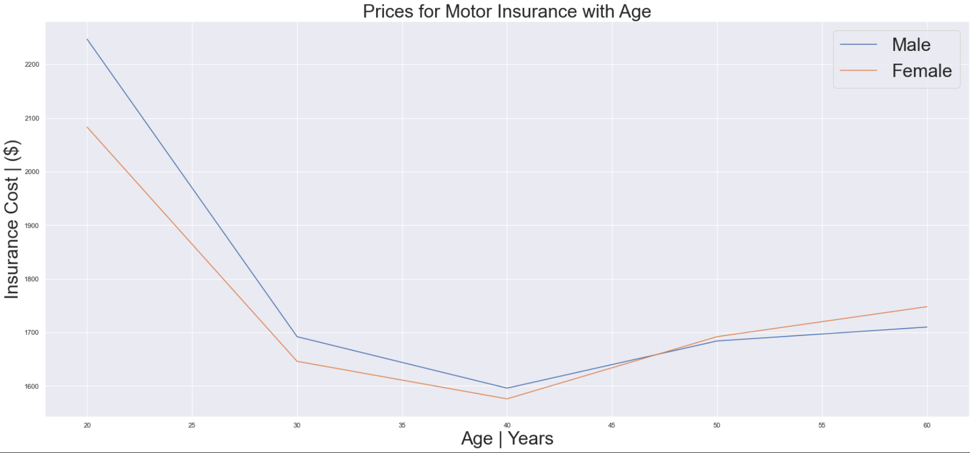
Should I purchase insurance? when should I purchase insurance?

Slide 31
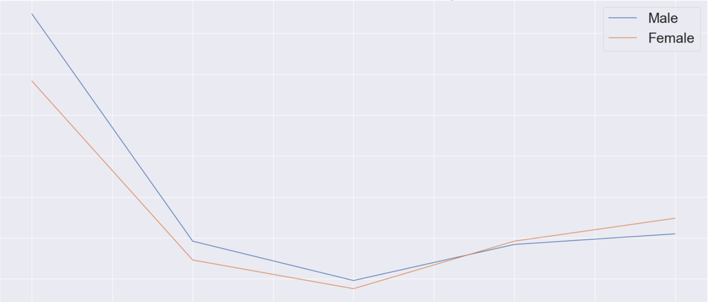
Explanation of insights
Slight v shape, heavily skewed towards consumers of a younger age
lack experience and time driving
average of $2150 for both genders at 20 years old
value drops significantly 20 years later, by about 30%
seasoned drivers, and are less likely to get into an accident
increases by about 10% as we move older
elderly may face issues paying attention or having similar road awareness to their 40 year old counterparts

Slide 32
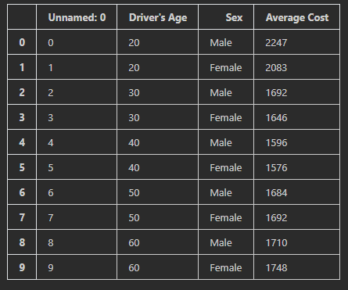
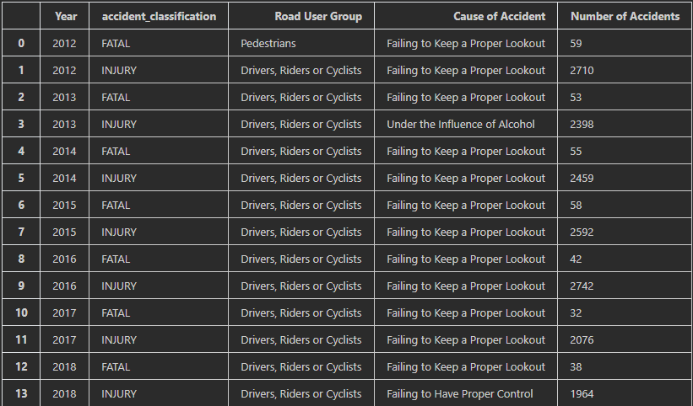
Data Dictionary
Average cost of insurance, per gender, per age group
No. of accidents per cause of accident, per road user group, per accident classification, per year

Slide 33
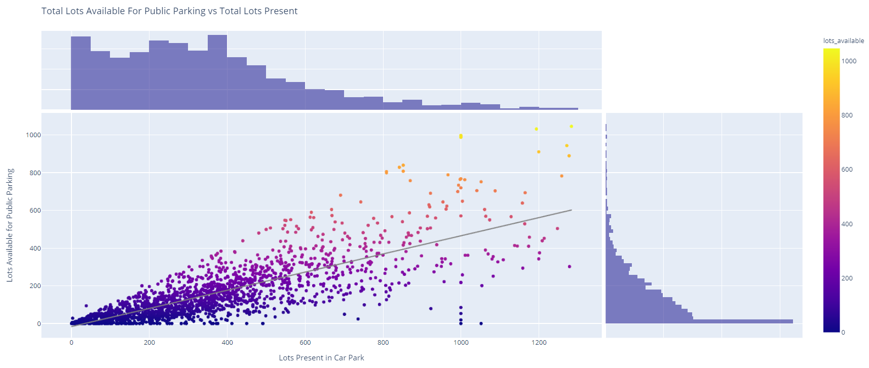
Where should I park my car? What should I look out for?

Slide 34



Explanation of insights
Distribution of lots present in carpark
proportion of lots available is linear to that of the number of lots present
values become more fanned out
reliability of the data and consistency of the data drops
doesn't follow the trendline
Even though the carpark has more lots, it doesn't mean that there will be as many available for me to park in
More than 1200 lots, it has lesser lots available for me to park in compared to this car park with 4 times as little lots present.
Since carparks are just simply occupied
trend is more common for residential carparks, where majority of the lots are already being used
$12 a day for seasonal parking
Distribution of available lots

Slide 35

what are my needs for a carpark? What type of carpark suits those needs?

Slide 36
Explanation of insights
majority of car parks are either surface, or multi-storey
majority of it is through electronic parking, about 90% of the time
majority of these multi storey car parks, have roughly 12 decks.
Find a carpark with those specifications

Slide 37


Data Dictionary
Distribution of Car Park Type, Type of Parking System, Gantry Height, No. of Car Park Decks and availability of:
1) Free Parking
2) Night Parking
3) Car Park Basement
No. of lots available per no. of lots present

Slide 38
Conclusion of insights
What are the most popular brand of cars sold and their respective models?
Purchase a Toyota Corolla, as it is reliable, efficient and budget friendly,
What road facilities am I provided with as a car buyer?
Annually-increasing road length
Annually increasing transport facilities and services such as Vehicular Bridges, Vehicle Underpass Tunnels, Traffic Lights etc.
How much are average fuel prices?
Average fuel prices are about $3.10 per liter, however due to volatile and unpredictable market conditions, said values may be prone to fluctuation.
How congested is Singapore? How many cars are on the road and how fast can I drive?
In terms of jam density, there is a 69.5% possibility to be caught in a jam in Singapore, if we consider the average number of vehicles per km in a jam to be 400.
Up by 1.4km/h since 2005, you can drive at an average speed of 64.1 Km/h on expressways, and 28.9 Km/h on arterial roads such as Orchard Road.
What are the most common accidents? If I get into an accident, what are the average vehicle insurance prices
The most common accidents occur when Drivers, Riders or Cyclists fail to keep a proper lookout on the road.
Such accidents require insurance prices that vary from age group to age group, with the most expensive being $2,247 for male adults in their 20’s, and the lowest being $1,576 for female adults in their 40’s.
After I’m done driving, where do I park my car?
The most common and easily accessible carparks available for usage are 10-12 deck multi-storey carparks that offer electronic parking.

Slide 39
credits
Amanda S., 2022. Why Is The Toyota Brand So Popular Among Consumers? [online] Driver’s AutoMart Available at: Why Is The Toyota Brand So Popular Among Consumers? (driversautomart.com) [Accessed 14 February 2022]
2022 Toyota Camry [online] US News Available at: 2022 Toyota Camry Prices, Reviews, & Pictures | U.S. News (usnews.com) [Accessed 14 February 2022]
Offical PR, 2022 Toyota Camry [online] WheelZome Available at: Why Is Toyota Corolla The World's Best-Selling Car? | Wheelz.me English [Accessed 14 February 2022]
See Kit, Tang,. Why are gas prices on the rise and what does this mean for Singapore? [online] CNA Available at: Why are gas prices on the rise and what does this mean for Singapore? - CNA (channelnewsasia.com) [Accessed 14 February 2022]

